Slide 1
Azure AI / IoT Hands-On Lab Last Updated - Oct, 2020
Tyler Chessman & Ravi Tella
(tylerc@microsoft.com)
(ratella@microsoft.com)

Slide 2
AGENDA
Introduction to Azure AI & IoT
Use Case Introduction - Predictive Maintenance
Hands-On Exercises
Wrap Up & Next Steps

Slide 3





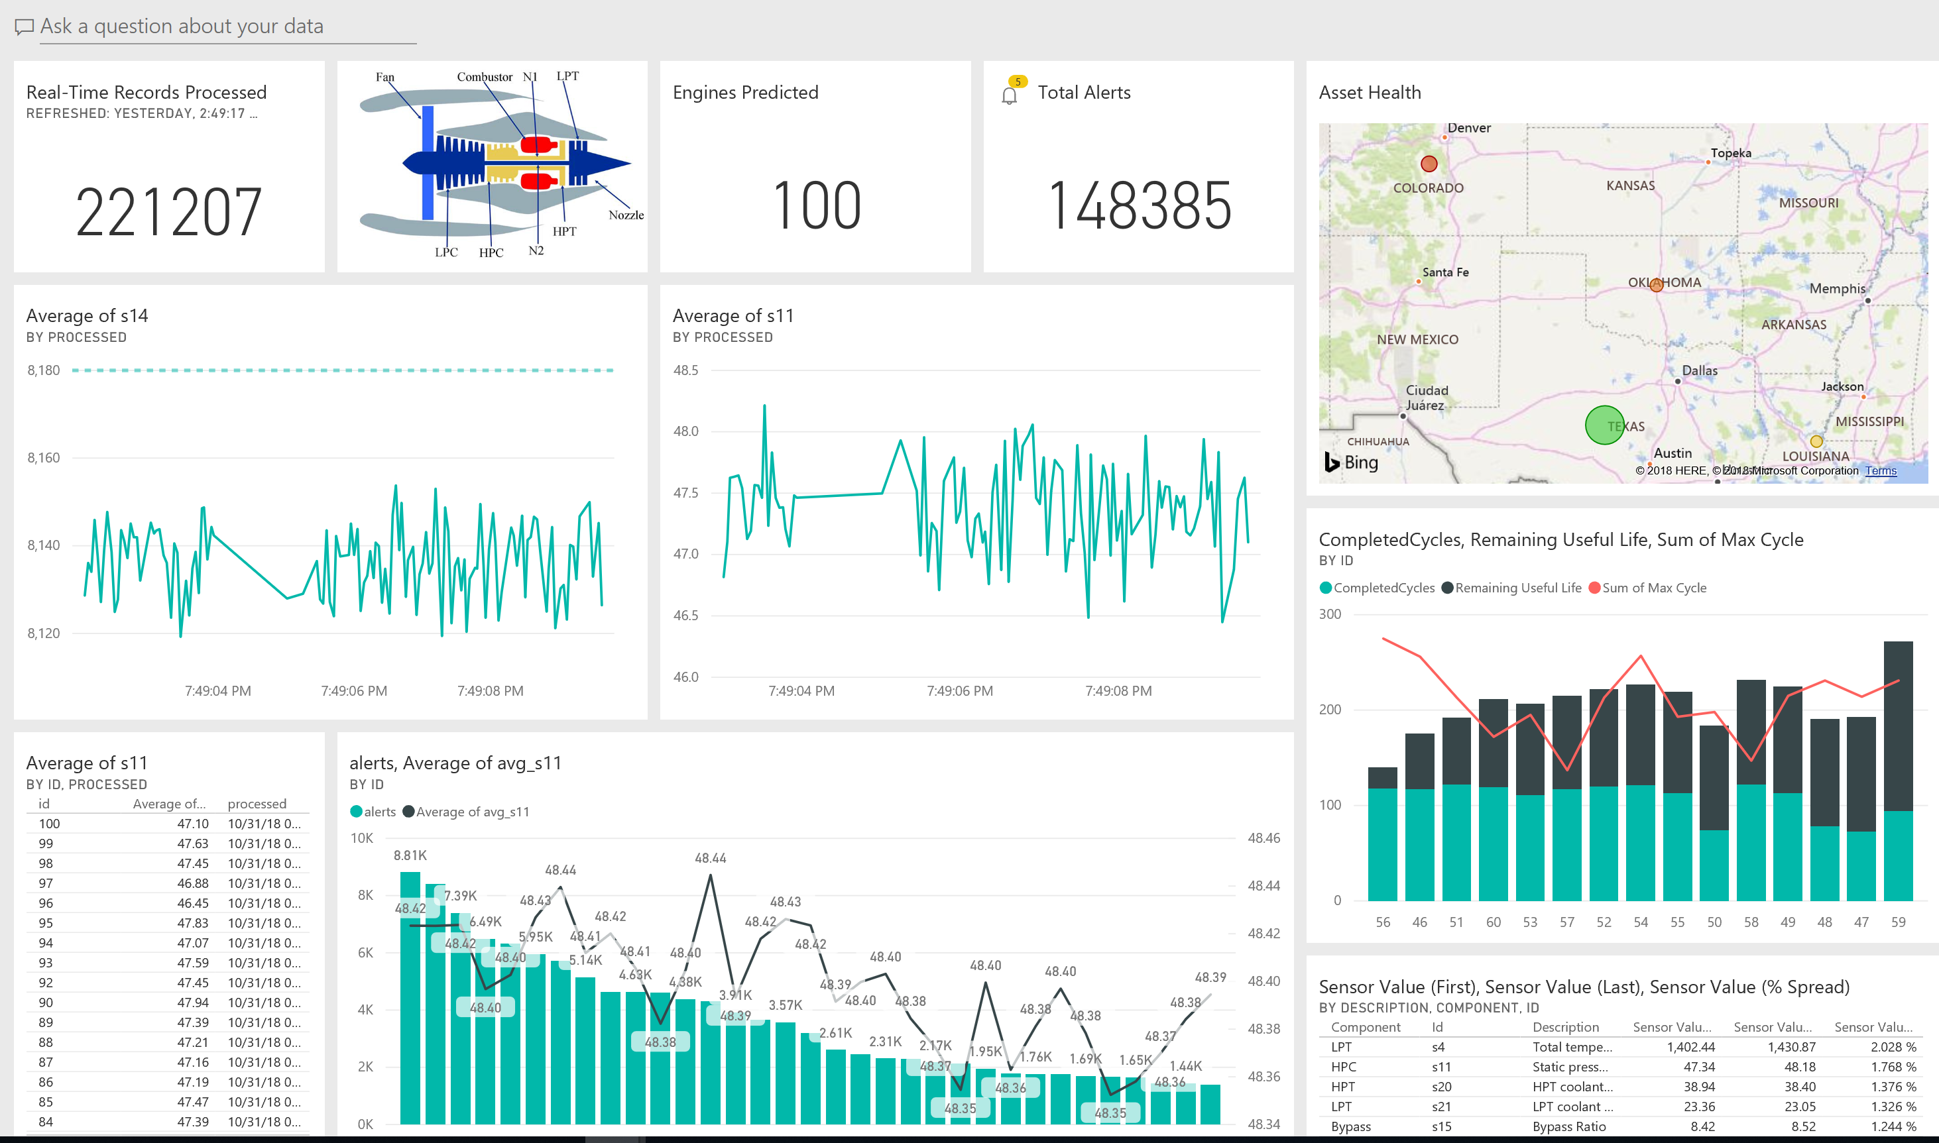
Reference Architecture Asset Monitoring / Predictive Maintenance
HDInsight /
Spark
Azure
Data Factory
AMQP
Https
Notes
Summary data scored by Azure ML
Scored results sent back to Azure SQL
Aggregate
Into Storage (Tumbling Window)
Azure
Machine Learning
Event Ingress –
Azure Event Hubs
Azure Storage
Push to
Power BI
RUL Results (once every 180 minutes)
Azure
SQL Database
Event Publishers e.g.,
Devices, Services
Event Consumer -
Azure Stream Analytics
Power BI
Cloud Gateway
Azure IoT Hub
Edge /
Gateway

Slide 4
Demo
Predictive Maintenance

Slide 5
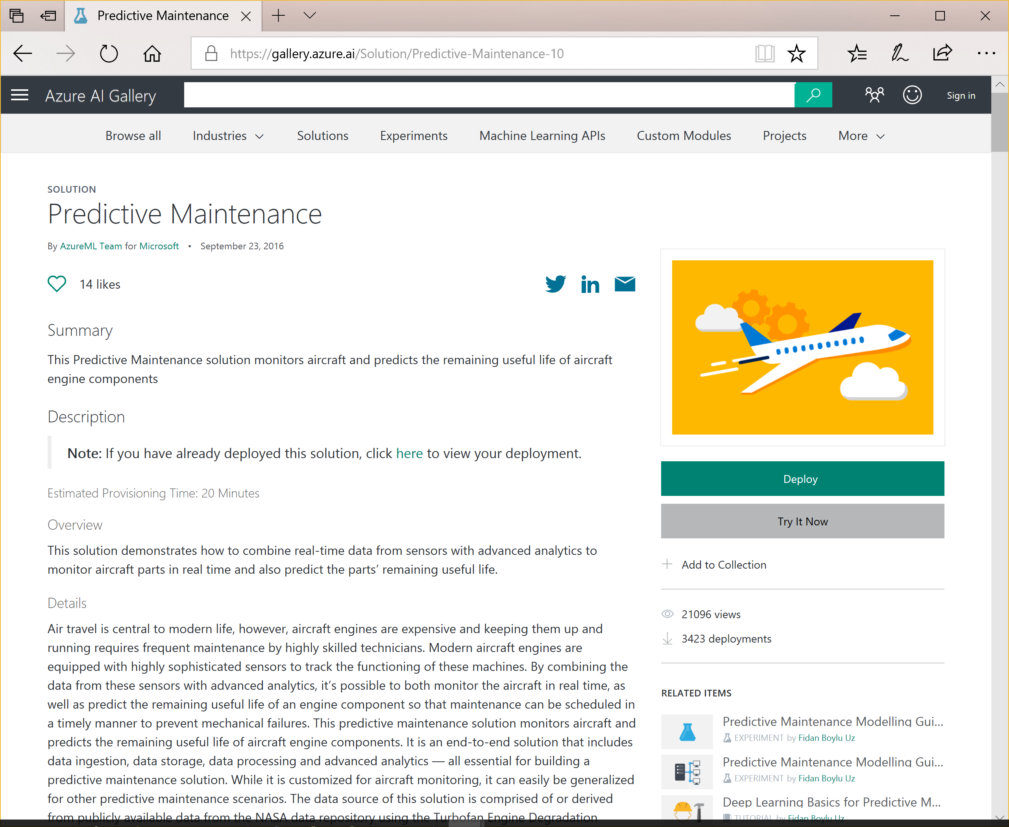
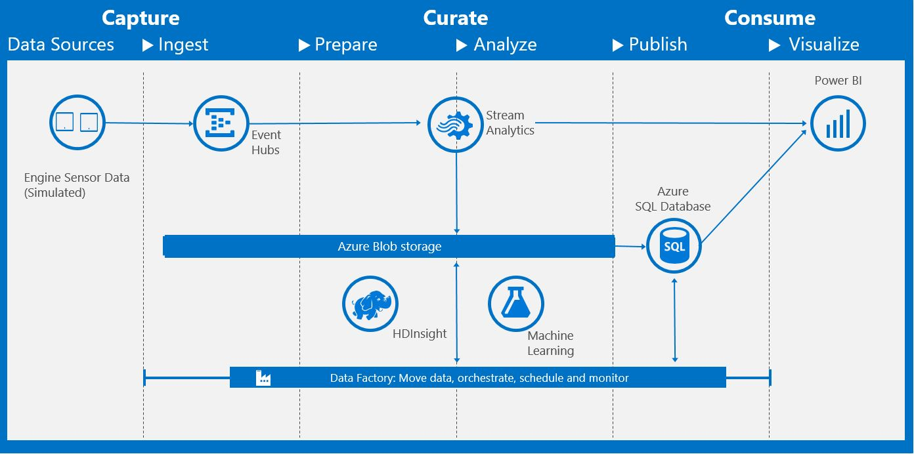
Azure AI Solution Templates
“This solution demonstrates how to combine real-time data from sensors with advanced analytics to monitor parts in real time and also predict the parts’ remaining useful life..
Deploys necessary components into an Azure subscription
https://gallery.azure.ai/Solution/Predictive-Maintenance-10

Slide 6
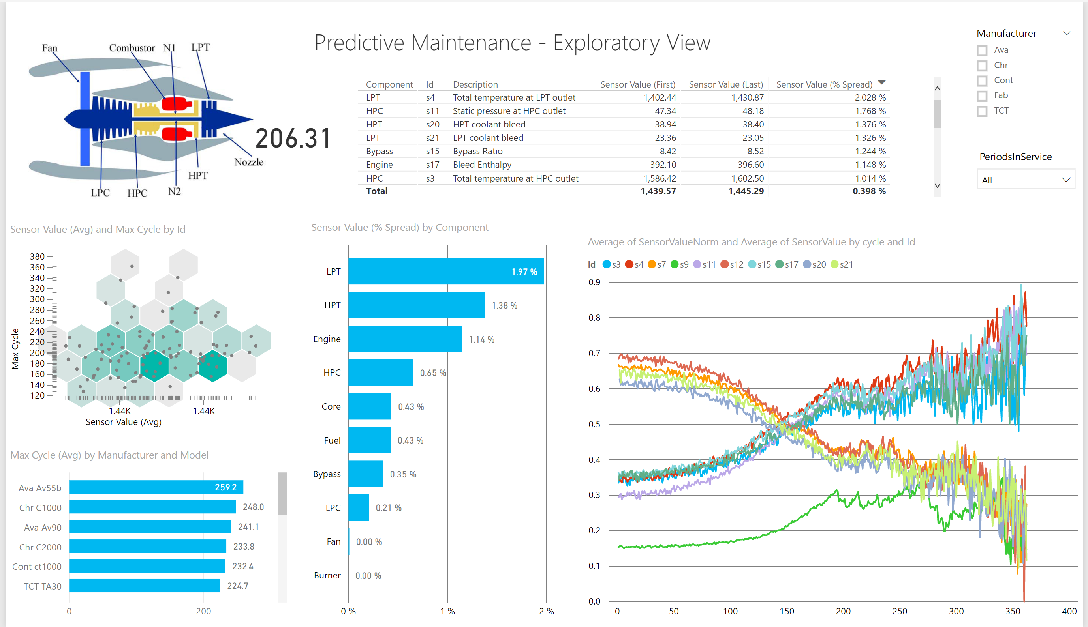
Hands-On
Lab 0 – Explore Historical Data

Slide 7
AGENDA
Introduction to Azure AI & IoT
Use Case Introduction - Predictive Maintenance
Hands-On Exercises
Wrap Up & Next Steps

Slide 8
Machine Learning & AI Portfolio When to use what?
Microsoft ML & AI products
Build your own or consume pre-trained models?
Build your own
Consume
Machine Learning / AI
Cognitive services*
*Some Cognitive Services (e.g., Vision) support code-free customization
Which experience do you want?
Code first
Visual tooling
(Cloud)
Deployment target
(On-prem) ML Server
Azure Machine Learning
Azure Synapse
Azure
DSVM
GitHub Codespaces
Power BI (ML)
Azure ML Visual Designer,
Azure ML Studio (classic)
What engine(s) do you want to use?
On-prem Hadoop**
SQL Server
Local,
ML compute instance or cluster,
AKS***
Azure Containers,
IoT Edge
Spark
** Can also be deployed to HDInsight
*** https://docs.microsoft.com/en-us/azure/machine-learning/concept-compute-target
Notes:
https://docs.microsoft.com/en-us/azure/machine-learning/concept-compute-target

Slide 9
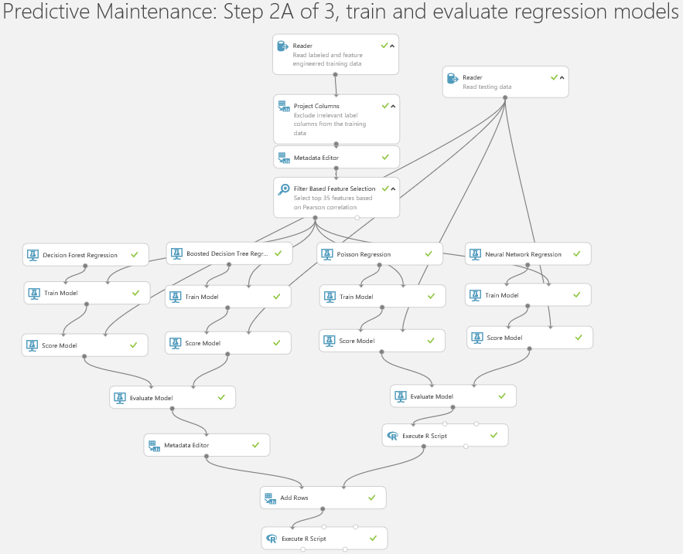
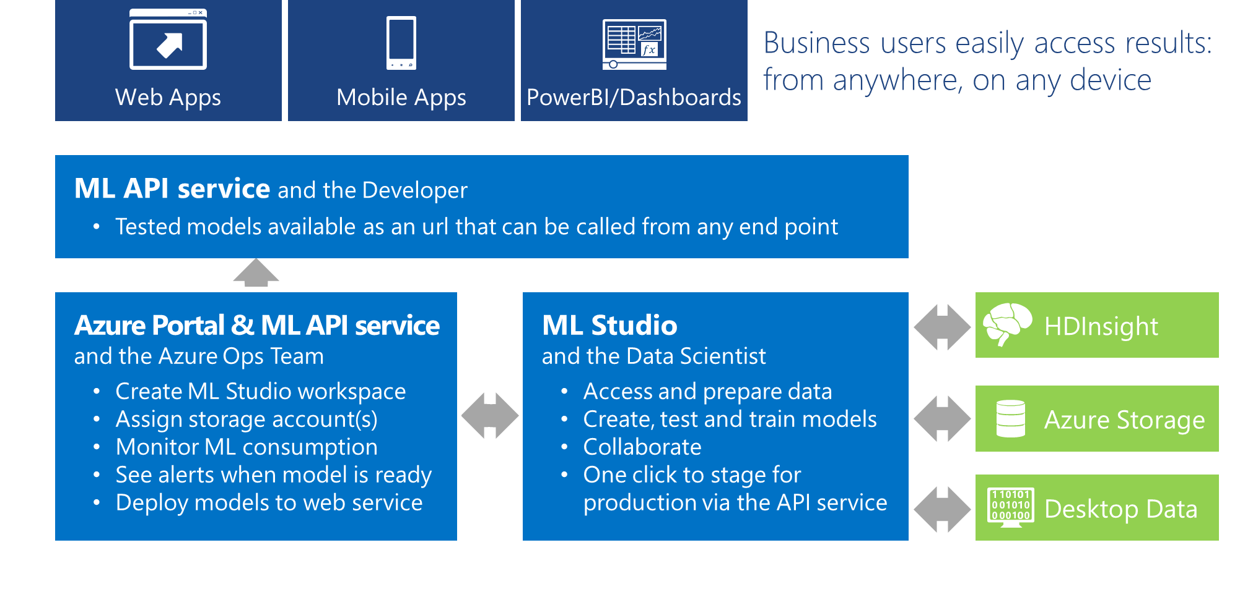
Reference Architecture Azure Machine Learning (ML) Studio Classic*
A complete solution for advanced analytics in the cloud
Build/run/evaluate machine learning experiments in the browser – no client-side software needed
Connect to on-premise and/or cloud data
Quickly deploy experiments as web services to call from external applications.
*Azure Machine Learning Studio (classic) is a cloud service (https://studio.azureml.net/) – Consider using the new studio experience in Azure Machine Learning - https://azure.microsoft.com/en-us/services/machine-learning/#documentation

Slide 10
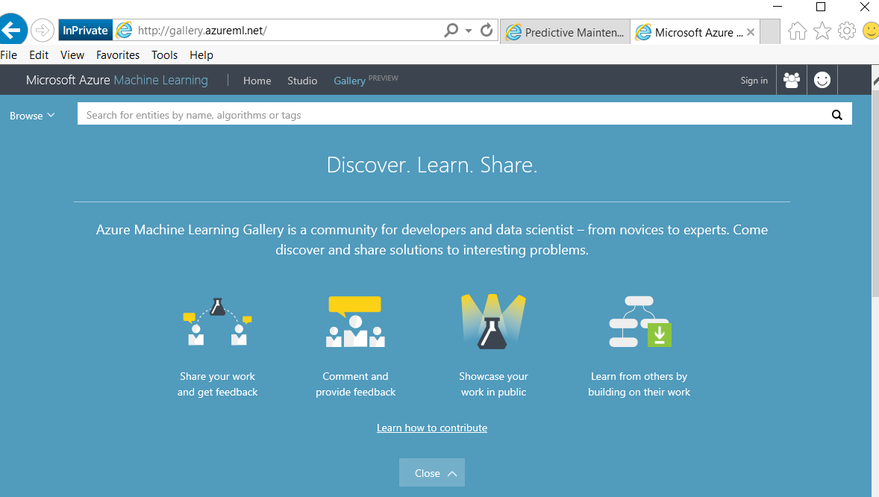
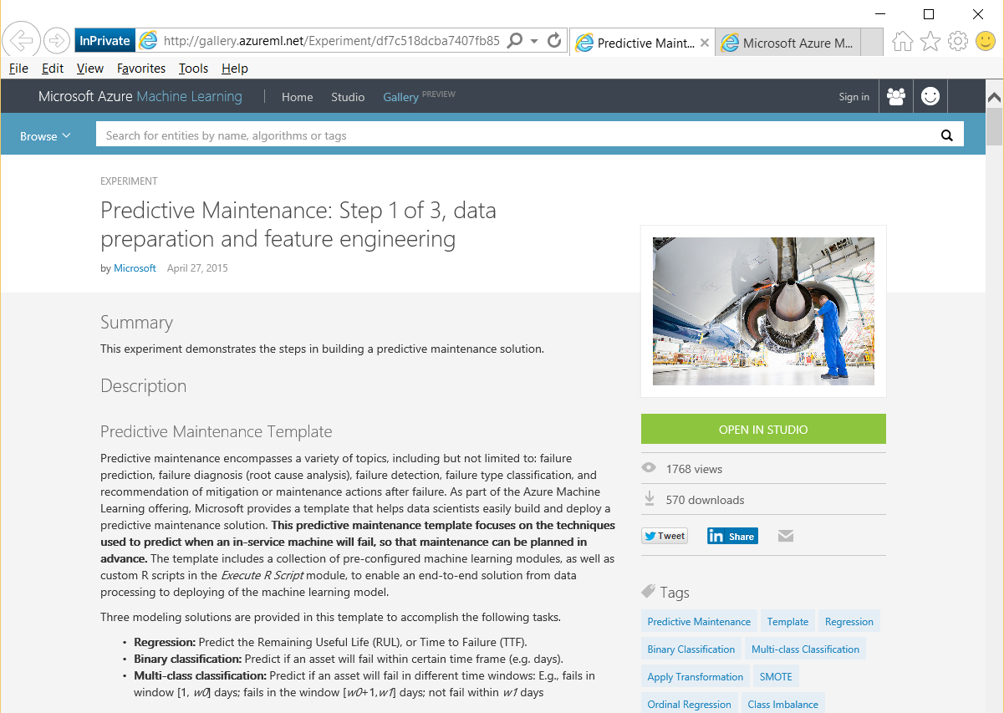
The Predictive Maintenance Template Azure Machine Learning (ML)
Available in the Azure Gallery
Built by Microsoft Data Scientists
“…focuses on the techniques used to predict when an in-service machine will fail, so that maintenance can be planned in advance.
Includes a collection of pre-configured ml modules, and custom R scripts, to enable end-to-end solution from data processing to deployment

Slide 11
Machine Learning Flow Typical Lifecycle
Deploy Solution
Define Objective
Collect & Prepare Data
Train Model
Analyze Results
Define Objective
Collect & Prepare Data
Normalizing features & feature selection
Splitting
Train Model
Algorithm selection
Parameter sweeping
Analyze Results
Scoring and evaluation
Iterating
Deploy

Slide 12
Deploy Solution
Machine Learning Flow Define Objective
Define Objective
Collect & Prepare Data
Train Model
Analyze Results
Proactively predict when equipment may fail
Remaining Useful Life (RUL) or Time to Failure (TTF)
Likelihood of failure within a certain time period (within w1 cycles)
Likelihood of failure within a set of windows (w0, w1, etc.)
Discussion – your particular use case(s)
Predictive Maintenance or other areas…
Segmentation (Clustering)
Classification/Prediction
Estimate/Forecast

Slide 13
Deploy Solution
Machine Learning Flow Collect and Prepare Data
Define Objective
Collect & Prepare Data
Train Model
Analyze Results
The datasets for this template
Training data: engine run-to-failure data.
Testing data: engine operating data without failure events recorded.
Ground truth data: the true remaining cycles for each engine in the testing data.
More about the training data
train_FD001.txt, http://azuremlsamples.azureml.net/templatedata/PM_train.txt
Contains 20631 records, for 100 engines (denoted by id).
Each engine contains 21 sensor recordings (s1-s21) across a varying number of time periods (cycle).
The last cycle recorded is at the point of failure.
Three setting columns (setting1-3) are also included - though setting3 is a constant value across all rows.

Slide 14
Deploy Solution
Machine Learning Flow Choosing the Right Model
Define Objective
Collect & Prepare Data
Train Model
Analyze Results
These templates focus on:
Regression - predicting a numeric (dependent) variable based on 1 or more independent variable
Binary classification – e.g., Yes/No, On/Off
Multi-class classification – e.g., Short, Medium, Tall
How do you know which algorithm to choose?
Reference – The Machine Learning Algorithm Cheat Sheet*
Different types of machine learning
Supervised – make predictions based on a set of examples
Unsupervised – data points have no labels associated with them; the goal is to organize the data
Reinforcement Learning - the algorithm gets to choose an action in response to each data point (currently not natively available in ML)
Considerations when choosing an algorithm
Accuracy
Training time
Linearity
Number of Parameter
Number of Features
*https://azure.microsoft.com/en-us/documentation/articles/machine-learning-algorithm-cheat-sheet/

Slide 15
Deploy Solution
Machine Learning Flow Step 2a: Train & Evaluate Regression Models
Define Objective
Collect & Prepare Data
Train Model
Analyze Results
Goal – predict time to failure i.e. remaining cycles
Train/Score 4 regression models
Decision Forest Regression
Decision Trees are non-parametric models that perform a sequence of simple tests for each instance, traversing a binary tree structure until a leaf node (decision) is reached. This regression model consists of an ensemble (blended result) of decision trees
Boosted Decision Tree Regression
Creates an ensemble of regression trees using boosting – each tree is dependent on prior trees, and learns by filtering the residual of the trees that preceded it (tends to improve accuracy with some small risk of less coverage)
Poisson Regression
Valid for predicting numeric values – typically counts
Poisson distribution is a discrete probability distribution (limited number of possible observations)
Neural Network Regression
From the SQL Server Data Mining book…. Neural networks works by creating and training artificial neural paths (relationships between inputs and outputs) that are used as patterns for further predictions.
Filter-based feature selection
Pearson correlation to narrow independent variables (features)
All 4 models are scored – results are presented in a table

Slide 16
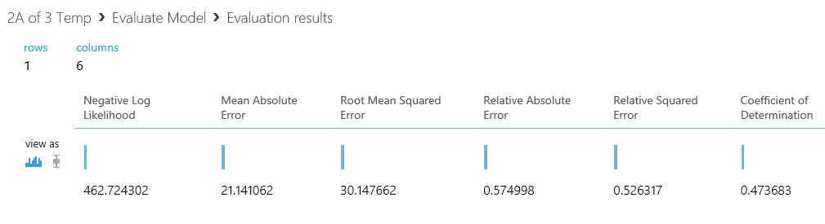
Deploy Solution
Machine Learning Flow Step 2a: Train & Evaluate Regression Models
Define Objective
Collect & Prepare Data
Train Model
Analyze Results
How should you evaluate a regression model?
Closest with going over (Price is Right)
Closest to actual (allow errors to cancel each other out)
Closest to actual (evaluate errors in terms of absolute value)
No prediction should fall outside of a certain threshold (e.g., 15% error)
Evaluate results in Azure ML*
*Log Likelihood not available for all model; Compare Regression models - http://gallery.azureml.net/Experiment/f35e1ba8a0a34ccd9ce2dc0758de34cb

Slide 17
Hands-On
Lab 1 – Azure Machine Learning Studio

Slide 18
Optional
Hands-On
Lab 2 – Evaluate Regression Metrics

Slide 19
Hands-On
Lab 3 – Deploy Web Service

Slide 20
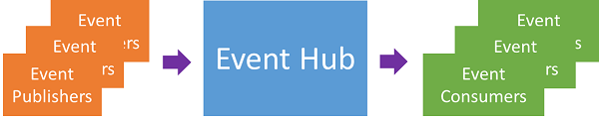
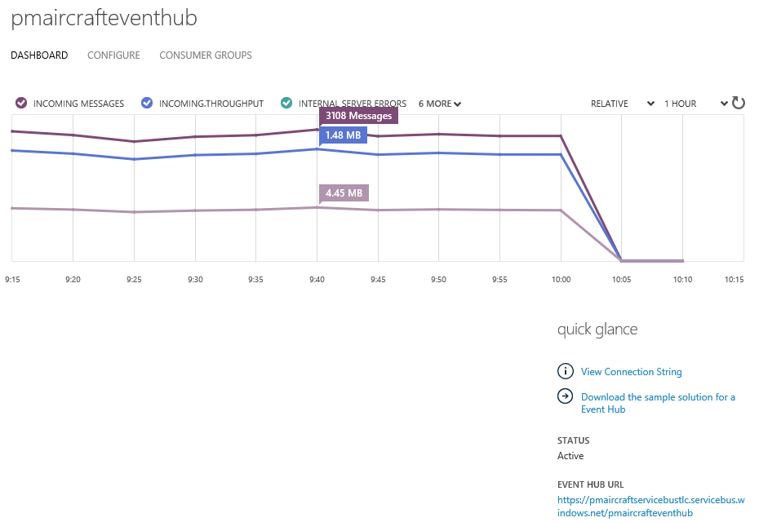
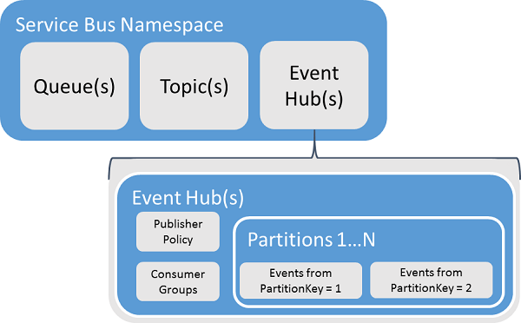
Reference Architecture Azure Event Hubs
“Azure Event Hubs is an event processing service that provides event and telemetry ingress to the cloud at massive scale” - https://azure.microsoft.com/en-us/documentation/articles/event-hubs-overview/
Notes:
-Queues offer First In, First Out (FIFO) message delivery to one or more competing consumers
-In contrast to queues, in which each message is processed by a single consumer, topics and subscriptions provide a one-to-many form of communication, in a publish/subscribe pattern
-Event Hubs is an event processing service, used to provide event and telemetry ingress to Azure at massive scale, with low latency and high reliability.
This service, when used with other downstream services, is particularly useful in application instrumentation, user experience or workflow processing, and Internet of Things (IoT) scenarios.
Event Hubs are a message streaming construct, and although they may appear similar to queues and topics, they have very different characteristics.
For example, Event Hubs do not provide message TTL, deadlettering, transactions, or acknowledgments as these are traditional brokered messaging features not streaming features.
Event Hubs provide other stream-related features such as partitioning, preserving order, and stream replay.

Slide 21
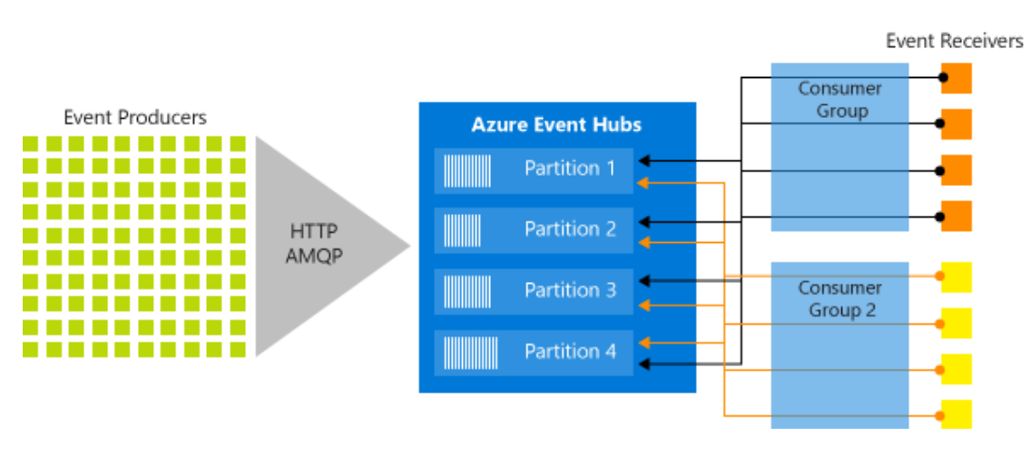
Reference Architecture Azure Event Hubs
Event Hubs contains the following key components:
Event producers: Any entity that sends data to an event hub. Event publishers can publish events using HTTPS or AMQP 1.0 or Apache Kafka (1.0 and above)
Partitions: Each consumer only reads a specific subset, or partition, of the message stream.
Consumer groups: A view (state, position, or offset) of an entire event hub. Consumer groups enable consuming applications to each have a separate view of the event stream. They read the stream independently at their own pace and with their own offsets.
Throughput units: Pre-purchased units of capacity that control the throughput capacity of Event Hubs.
Event receivers: Any entity that reads event data from an event hub. All Event Hubs consumers connect via the AMQP 1.0 session. The Event Hubs service delivers events through a session as they become available. All Kafka consumers connect via the Kafka protocol 1.0 and later.
“Azure Event Hubs is a big data streaming platform and event ingestion service. It can receive and process millions of events per second. Data sent to an event hub can be transformed and stored by using any real-time analytics provider or batching/storage adapters.” - https://azure.microsoft.com/en-us/documentation/articles/event-hubs-overview/
Notes:
-Queues offer First In, First Out (FIFO) message delivery to one or more competing consumers
-In contrast to queues, in which each message is processed by a single consumer, topics and subscriptions provide a one-to-many form of communication, in a publish/subscribe pattern
-Event Hubs is an event processing service, used to provide event and telemetry ingress to Azure at massive scale, with low latency and high reliability.
This service, when used with other downstream services, is particularly useful in application instrumentation, user experience or workflow processing, and Internet of Things (IoT) scenarios.
Event Hubs are a message streaming construct, and although they may appear similar to queues and topics, they have very different characteristics.
For example, Event Hubs do not provide message TTL, deadlettering, transactions, or acknowledgments as these are traditional brokered messaging features not streaming features.
Event Hubs provide other stream-related features such as partitioning, preserving order, and stream replay.

Slide 22
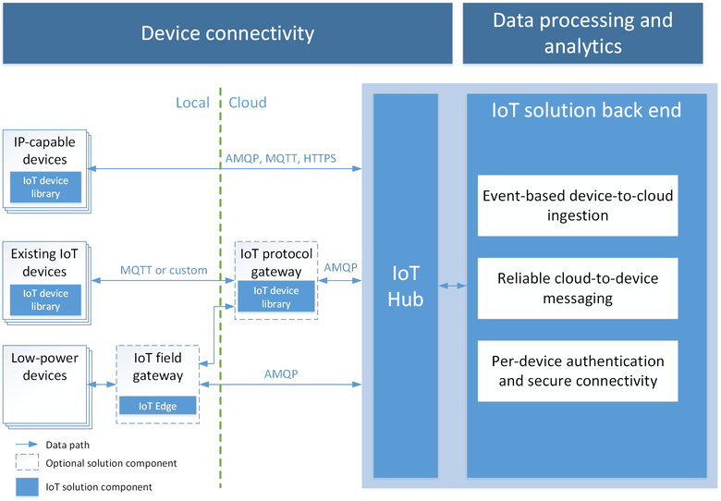
Reference Architecture Azure Iot Hub
Designed for IoT
Connect millions of devices
Per-device authentication
Security
X.509 via AMQPS/HTTPS
Use IoT Hub to enable secure bi-directional comms
IP Filtering
Cloud-scale messaging
Device-to-cloud and Cloud-to-device
Durable messages (at least once semantics)
File upload support in portal
Cloud-facing feedback
Delivery receipts, expired messages
Device communication errors
Multi-platform
Device SDKs (e.g. RTOS, Linux, Windows, iOS, Android)
Multi-platform Service SDK
“Azure Iot Hub is a fully managed service that enables reliable and secure bidirectional communications between millions of IoT devices and a solution back end” - https://docs.microsoft.com/en-us/azure/iot-hub/iot-hub-what-is-iot-hub
Notes:
Native support for AMQP/MQTT over WebSocket
Added a new S3 SKU for high volume
IoT Hub bulk identity import / export
X.509 via AMQPS/HTTPS
Monitoring metrics exported into MDM
File upload support in portal
New changes to Azure portal for Device management (Create DM Enabled Hub, Added Device Explorer)
With Azure IoT support for X.509 certificates, an IoT device can now store a private key locally, and an associated device X.509 certificate generated to identify the device to Azure IoT Hub before the information is transmitted.
Supported X.509 certificates
You can use any X.509 certificate to authenticate a device with IoT Hub. This includes:
- An existing X.509 certificate. A device may already have an X.509 certificate associated with it. The device can use this certificate to authenticate with IoT Hub.
- A self-generated and self-signed X-509 certificate. A device manufacturer or in-house deployer can generate these certificates and store the corresponding private key (and certificate) on the device. You can use tools such as OpenSSL and Windows SelfSignedCertificate utility for this purpose.
- CA-signed X.509 certificate. You can also use an X.509 certificate generated and signed by a Certification Authority (CA) to identify a device and authenticate a device with IoT Hub.

Slide 23
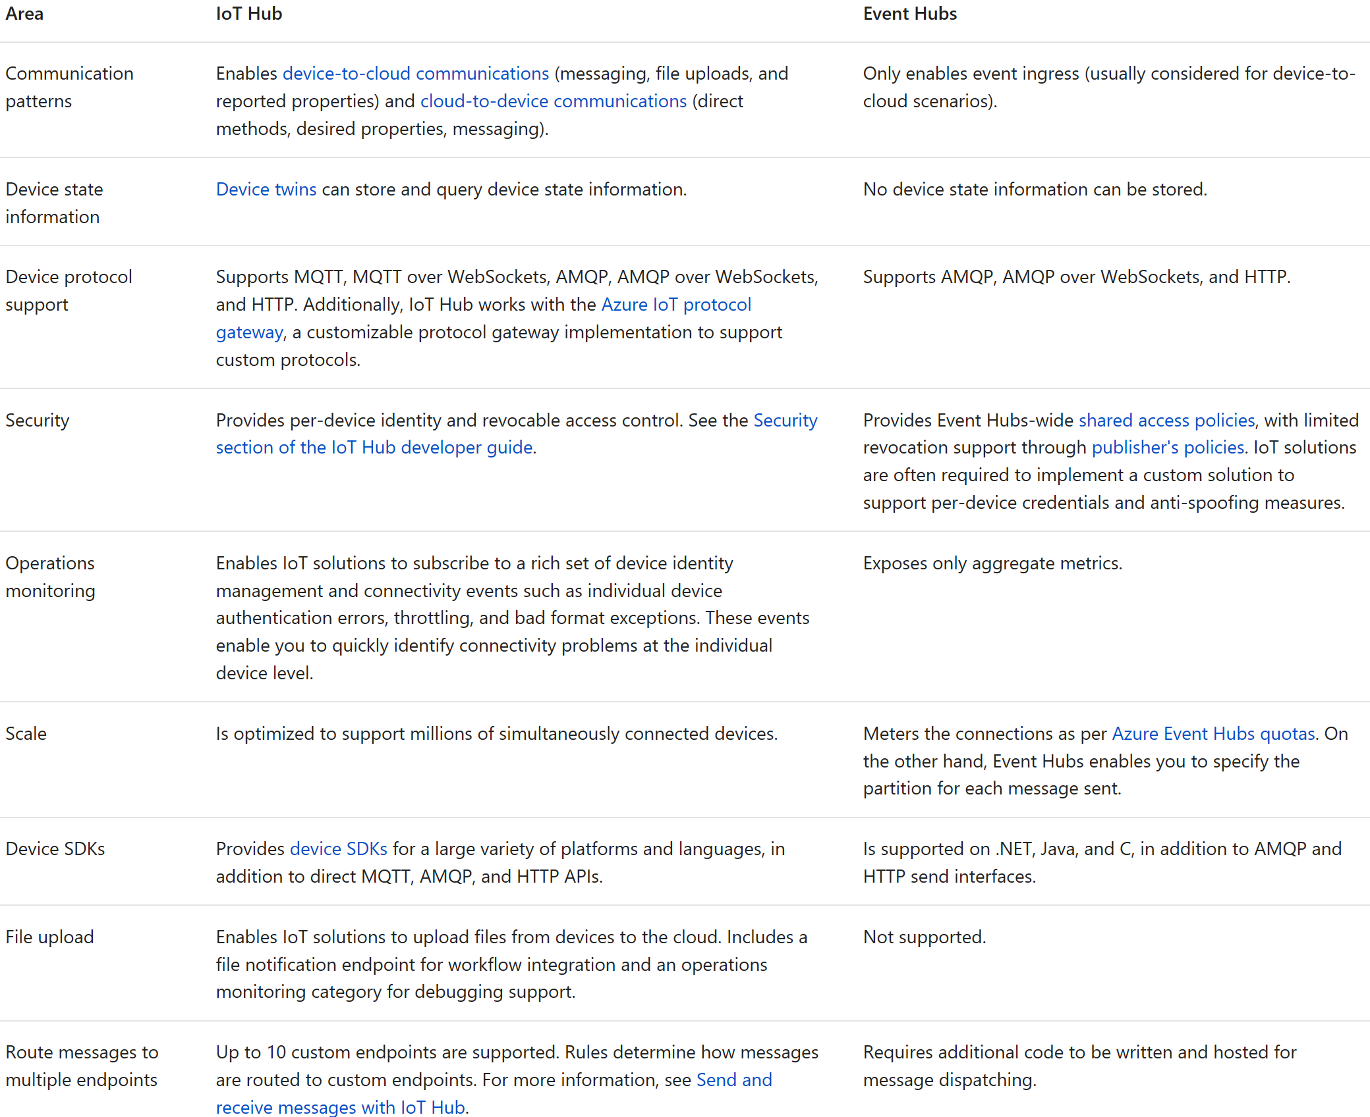
Azure Event Hubs / IOT Hubs docs.microsoft.com/en-us/azure/iot-hub/iot-hub-compare-event-hubs
Like IoT Hub, Event Hubs is an event processing service for event/telemetry ingress to the cloud – at low latency and high reliability.
IoT Hub provides a service that is designed for IoT device connectivity
Event Hubs is designed for event ingress at a massive scale, both in the context of inter-datacenter and intra-datacenter scenarios
It is not uncommon to use both IoT Hub and Event Hubs
IoT Hub handles the device-to-cloud communication
Event Hubs handles later-stage event ingress into real-time processing engines..
Notes:
Azure IoT Hub is a fully managed service that enables reliable and secure bidirectional communications between millions of IoT devices and a solution back end. Azure IoT Hub

Slide 24
Azure Event Hubs The Basics
Configuration
Partitions – specified at creation (2-32, default 4), cannot be changed afterwards
a data organization mechanism … more related to the degree of downstream parallelism … than to throughput.
makes the choice of the # of partitions directly related to the number of concurrent readers you expect to have
Throughput Units (1-20) – configurable, each unit specifies:
Data Ingress (1MB per second)
Data Egress (2 MB per second)
Event Storage (84 GB)
Consumer Groups - a view (state, position, or offset) of an entire Event hub; configurable
enable multiple consuming applications to each have a separate view of the event stream, and to read the stream independently at their own pace and with their own offsets
Data Retention – number in days, default 7; configurable
Event Publishers - an entity that sends events to Event Hubs
Can publish using either HTTPS or AMQP 1.0 (EventHubClient class for .NET)
Each publishing event (single or batch) limited to 256KB
Event Consumers – an entity that reads event data from an Event hub
Use AMQP
Azure Stream Analytics (ASA) is a “built-in” event consumer

Slide 25
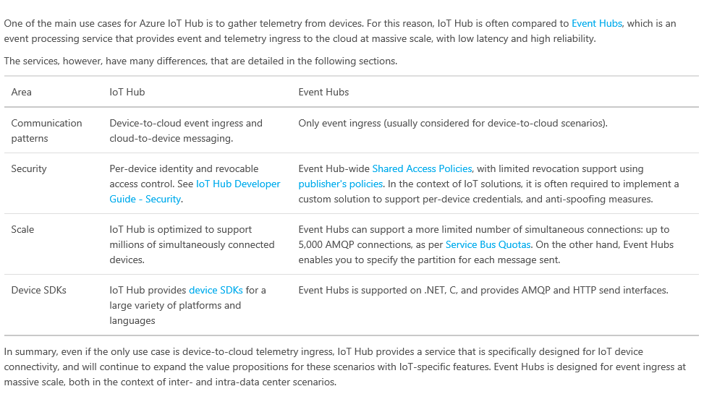
Azure Event Hubs / IOT Hubs Comparison
https://azure.microsoft.com/en-us/documentation/articles/iot-hub-compare-event-hubs/

Slide 26
Hands-On
Lab 4 – Configure Event Hubs

Slide 27
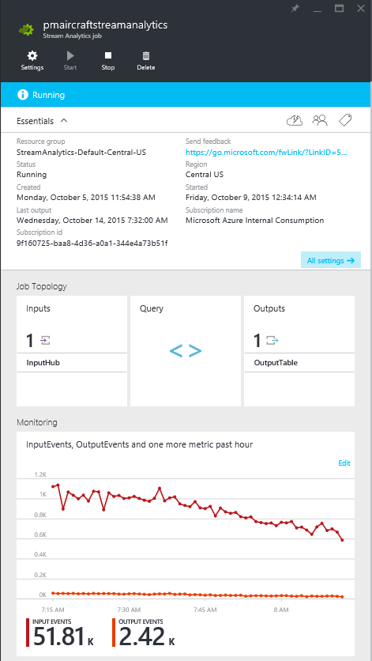
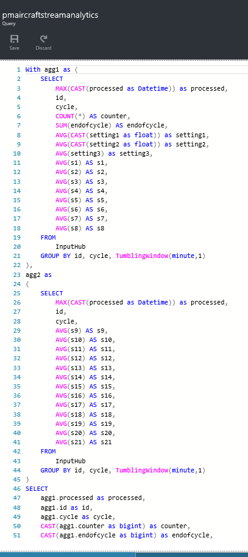
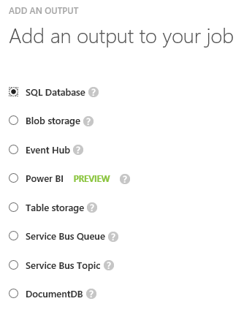
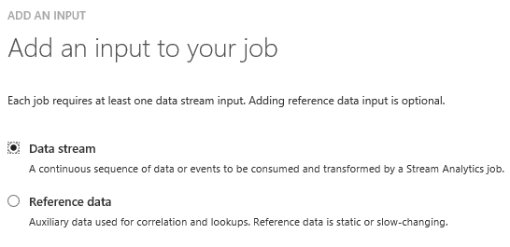
Reference Architecture Azure Stream Analytics (ASA)
Real Time Analytics
Intake millions of events per second (up to 1 GB/s)
Easy processing on continuous streams of data
Correlate between different streams, or with static data
Find patterns or lack of patterns in data in real time
Fully Managed
No hardware acquisition and maintenance
Bypasses deployment expertise
Easily expand your business globally
“Azure Stream Analytics (ASA) is a fully managed, cost effective real-time event processing engine that helps to unlock deep insights from data” - https://azure.microsoft.com/en-us/documentation/articles/stream-analytics-introduction

Slide 28
Hands-On
Lab 5 – Configure Stream Analytics

Slide 29
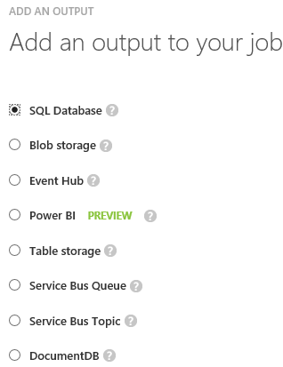
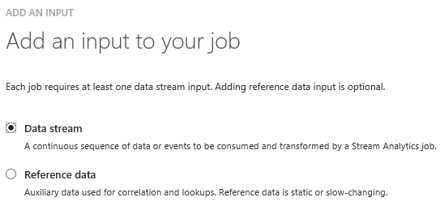
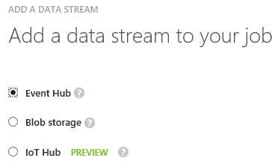
Azure Stream Analytics Defining an Input/Output
Inputs
Data Stream
Event Hub
Blob Storage
IoT Hub (In Preview)
Reference Data (used for correlation/lookups)
Azure Blob Storage
Data Stream – supported Event Serialization Formats
Avro
CSV
JSON
Outputs
Notes:
CSV: http://stackoverflow.com/questions/30868467/how-to-send-data-as-csv-on-eventhub-for-azure-stream-analytics

Slide 30
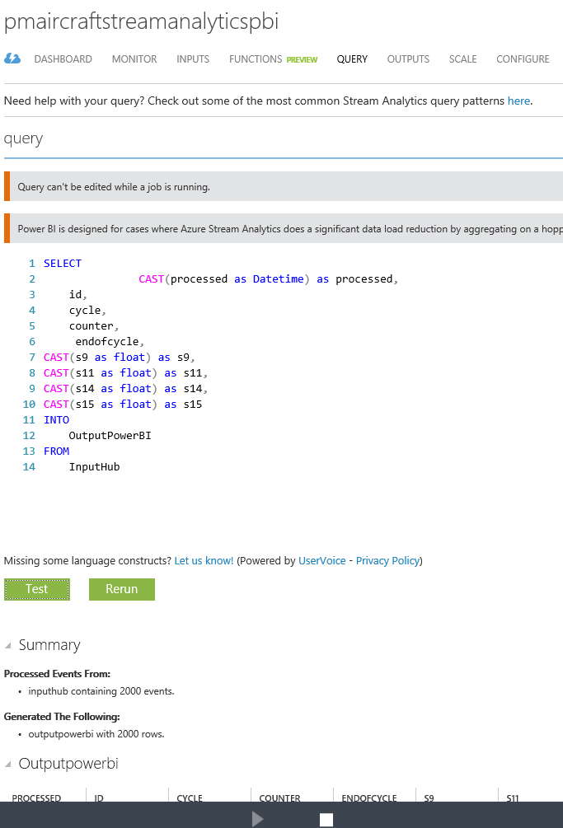
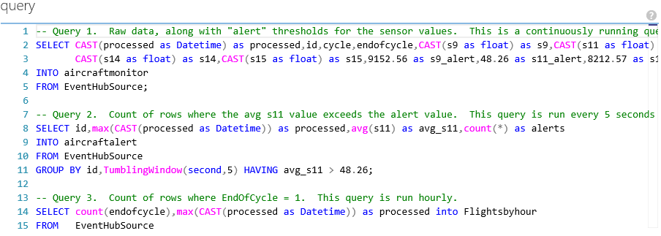
Azure Stream Analytics Defining/Testing a Query
Supported in legacy portal (as of Dec. 2015)
Allows you to upload a sample .json file to query against
Can sample data from Input (if available)
ASA supports a subset of SQL dialect - with additional windowing extensions
TumblingWindow
HoppingWindow
SlidingWindow
Tip – Define multiple queries to send to multiple outputs e.g.,
*Testing Requires JSON Format. Visit http://www.convertcsv.com/csv-to-json.htm if using .csv
Notes:
CSV: http://stackoverflow.com/questions/30868467/how-to-send-data-as-csv-on-eventhub-for-azure-stream-analytics

Slide 31
SAQL – Language & Library
DML
SELECT
FROM
WHERE
GROUP BY
HAVING
CASE WHEN THEN ELSE
INNER/LEFT OUTER JOIN
UNION
CROSS/OUTER APPLY
CAST
INTO
ORDER BY ASC, DSC
Date and Time Functions
DateName
DatePart
Day
Month
Year
DateTimeFromParts
DateDiff
DateAdd
Aggregate Functions
Sum
Count
Avg
Min
Max
StDev
StDevP
Var
VarP
Temporal Functions
Lag, IsFirst
CollectTop
String Functions
Len
Concat
CharIndex
Substring
PatIndex
Scaling Extensions
WITH
PARTITION BY
OVER
Windowing Extensions
TumblingWindow
HoppingWindow
SlidingWindow

Slide 32
Events and Time
Every event that flows through the system has a timestamp
User can pick it from the payload
SELECT * FROM InputStream TIMESTAMP BY CreatedAt
Or the system can assign timestamps automatically based on the event arrival time
SELECT * FROM InputStream
Projecting timestamp into payload
SELECT System.Timestamp AS Time, Id FROM InputStream
Note: System.Timestamp is a reserved property that exposes the timestamp of an event.

Slide 33
Windowing Concepts
Windows can be – Hopping, Sliding or Tumbling
Windows are fixed length
Output event will have the timestamp of the end of the window
Must be used in a GROUP BY clause
Window 1
Window 2
Window 3
1
5
4
6
2
8
6
4
Time
t1
t2
t3
t4
t5
t6
Aggregate
Function (Sum)
Output Events
18
14

Slide 34
Tumbling Windows
Tell me the count of tweets per time zone every 10 seconds
A 10-second Tumbling Window
1
5
4
6
2
8
6
5
3
6
1
0
5
10
15
20
25
30
Time
(secs)
1
5
4
6
2
8
6
5
3
6
1
SELECT TimeZone, COUNT(*) AS Count
FROM TwitterStream TIMESTAMP BY CreatedAt
GROUP BY TimeZone, TumblingWindow(second,10)

Slide 35
Hopping Windows
A 10-second Hopping Window with a 5-second “Hop”
Every 5 seconds give me the count of tweets and the average sentiment score over the last 10 seconds
1
5
4
6
2
8
7
5
3
6
1
0
5
10
15
20
25
30
Time
(secs)
1
5
4
6
2
4
6
2
8
6
8
6
5
3
5
3
6
1
SELECT Topic, COUNT(*) AS TotalTweets, AVG(SentimentScore)
FROM TwitterStream TIMESTAMP BY CreatedAt
GROUP BY Topic, HoppingWindow(second, 10 , 5)

Slide 36
Sliding Windows
A 10-second Sliding Window
1
5
9
8
Give me the count of tweets for all topics which are tweeted more than 10 times in the last 10 seconds
0
5
10
15
20
25
Time
(secs)
1
1
5
1
5
9
8
SELECT Topic, COUNT(*) FROM TwitterStream
TIMESTAMP BY CreatedAt
GROUP BY Topic, SlidingWindow(second, 10)
HAVING COUNT(*) > 10
https://www.linkedin.com/pulse/explanation-azure-stream-analytics-time-windows-marco-parenzan

Slide 37
Joining multiple streams
List all users and the topics on which they switched their sentiment within a minute
Twitter Stream:
{“XO”, 4, “Ebola”}
{“Dip”, 2, “XBox”}
{“Jo”, 0, “ALS”}
{“Foo”,4, “ALS”}
Twitter Stream:
{“XO”, 0, “Ebola”}
{“Jo”, 4, “ALS”}
{“Dip”, 0, “Xbox”}
{“Foo”, 0, “ALS”}
time
SELECT TS1.UserName, TS1.Topic
FROM TwitterStream TS1 TIMESTAMP BY CreatedAt
JOIN TwitterStream TS2 TIMESTAMP BY CreatedAt
ON TS1.UserName = TS2.UserName AND TS1.Topic = TS2.Topic AND DATEDIFF(second, TS1, TS2) BETWEEN 1 AND 60
WHERE TS1.SentimentScore != TS2.SentimentScore

Slide 38
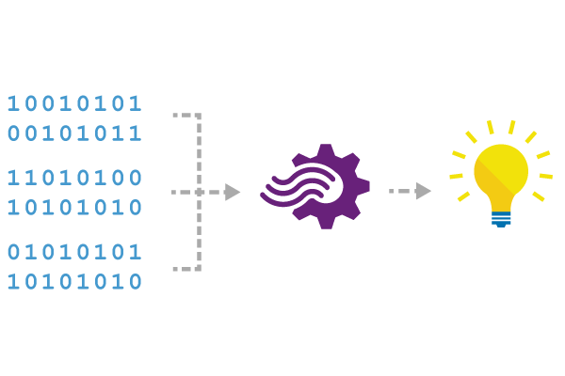
Reference Data
Seamless correlation of event streams with reference data
Static or slowly-changing data stored in blobs or databases
Same programming experience:
SELECT myRefData.Name, myStream.Value
FROM myStream JOIN myRefData
ON myStream.myKey = myRefData.myKey

Slide 39

Scaling Concepts – Partitions
SELECT COUNT(*) AS Count, Topic
FROM TwitterStream Partition By PartitionId
GROUP BY TumblingWindow (minute, 3), Topic
Partitioning allows for parallel execution
and scale out
Stream Analytics
Event Hub
PartitionId = 1
Query
Result 1
PartitionId = 2
Query
Result 2
PartitionId = 3
Query
Result 3
PartitionId = 1
PartitionId = 2
PartitionId = 3

Slide 40
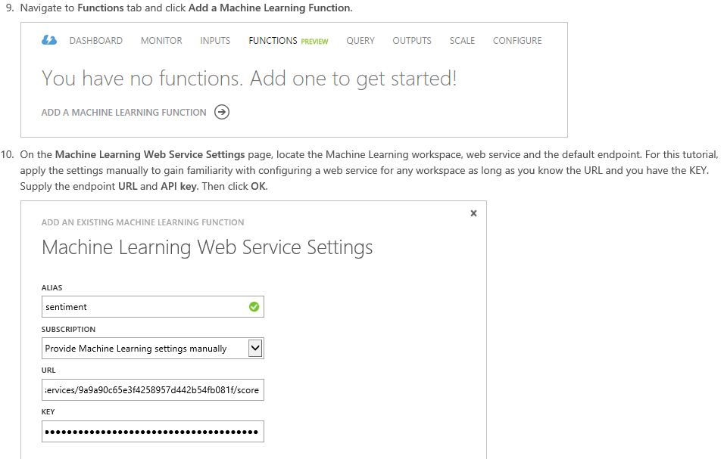
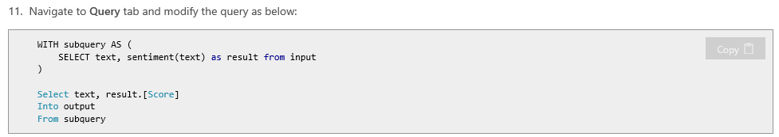
Azure Stream Analytics New Capability – Integration with Azure ML
https://azure.microsoft.com/en-us/documentation/articles/stream-analytics-machine-learning-integration-tutorial/
Notes:
Tip – use legacy portal - https://manage.windowsazure.com.

Slide 41
Demo
Azure Stream Analytics

Slide 42

Storing Data in Azure Understanding the Options
Azure Big Data Stores….
Azure Data Lake Store – a hyper-scale repository for big data analytics workloads
Azure SQL Data Warehouse Synapse Analytics - an elastic data warehouse/Spark Cluster as a service with enterprise-class features
Databricks & HDInsight - managed Apache Hadoop & Spark, HBase, and Storm made easy
What Else?
Azure Storage - Highly durable and scalable blob storage
Hbase - columnar NoSQL transactional database
Azure CosmosDB – a NoSQL document database-as-a-service, fully managed by Microsoft Azure
Azure Data Explorer
And more!!!
Big Data Stores
Machine Learning and Analytics
Azure
Machine Learning
Azure
Data Lake Store
Azure
Synapse Analytics
Azure Databricks,
HDInsight
Azure
Synapse Analytics
Azure
Stream Analytics
https://azure.microsoft.com/en-us/services/data-lake-store/
https://azure.microsoft.com/en-us/services/sql-data-warehouse/
https://azure.microsoft.com/en-us/services/hdinsight/

Slide 43





Azure Data Lake: Store
Analytics Service
HDInsight
Distributed, parallel file system in the cloud
Performance-tuned and optimized for analytics
No fixed size limits
Stores all data types
Highly available with local & geo redundant storage
WebHDFS REST API
Supported by leading Hadoop distros
Role-based security
Low latency and high throughput workloads
U-SQL
YARN
HDFS
Store
Applications
Devices
Sensors
Social
Relational
Web
Clickstream
Video

Slide 44
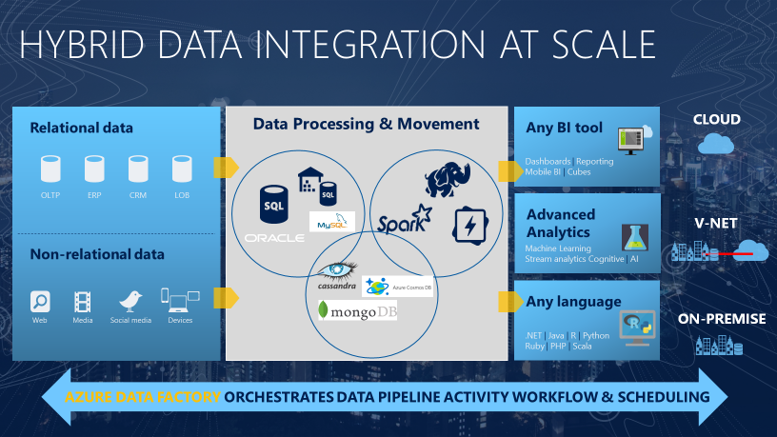
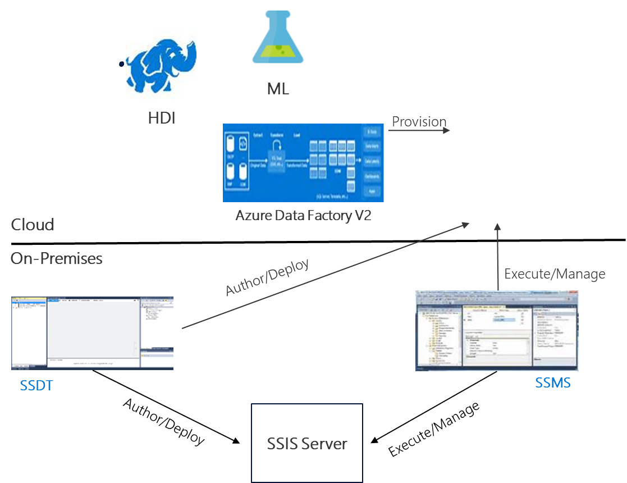
Reference Architecture Azure Data Factory (ADF)
Allows you to create data-driven workflows in the cloud for orchestrating and automating data movement & transformation.
New in v2! – Hosting of SQL Server Integration Services run-time
“Azure Data Factory is a managed cloud service that's built for these complex hybrid extract-transform-load (ETL), extract-load-transform (ELT), and data integration projects.” - https://docs.microsoft.com/en-us/azure/data-factory/introduction

Slide 45
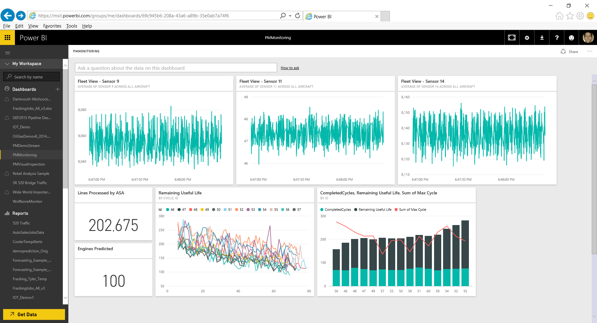
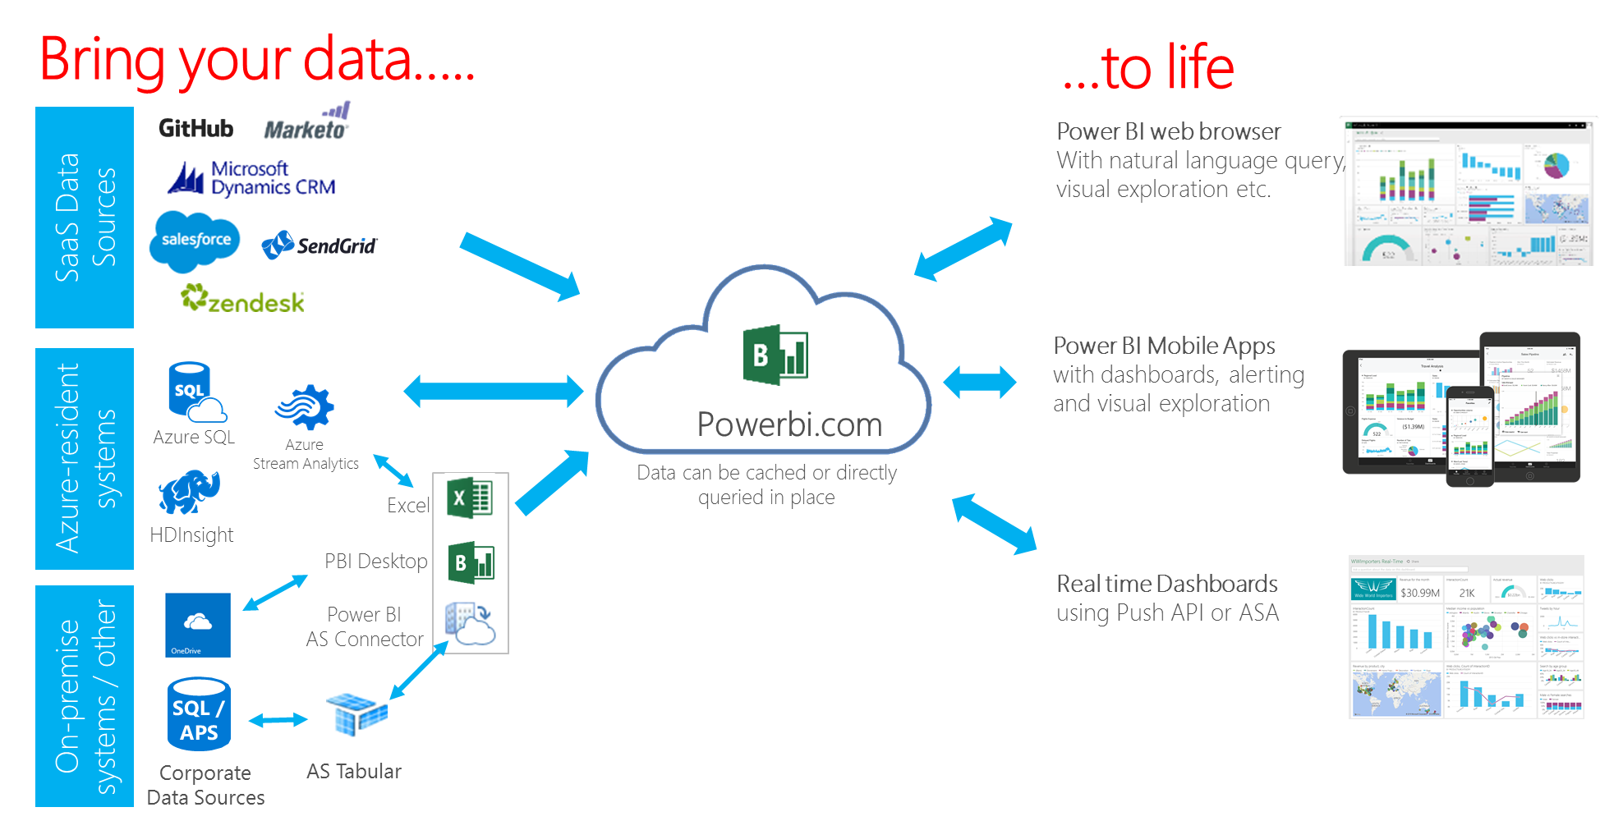
Reference Architecture Power BI
A cloud-based analytic service for both self-service and enterprise-driven BI scenarios
Data mashups in Excel/Power BI Desktop
Enterprise Data Sources (on-premise and/or in the cloud)
SaaS service data analytics
Real-time dashboards
“Power BI is a cloud-based business analytics service …Monitor the health of your business using a live dashboard, create rich interactive reports … and access your data on the go with native Mobile apps.” - powerbi.microsoft.com/en-us/features

Slide 46
Reference Architecture Power BI
The Solution Template exposes 2 datasets in the Power BI Dashboard*
Real-time data (pushed into Power BI) from Azure Stream Analytics
Note - the Power BI API also allows custom real-time dashboard development (i.e. independent of ASA)
Periodic Predictions from Azure ML (results are stored in an Azure SQL DB)
Dashboard Refresh
Dashboard tiles from real-time datasets are refreshed automatically as data changes
Other tiles are refreshed every ~10/15 minutes
Notes
Summary data scored by Azure ML
Scored results sent back to Azure SQL
Azure
HD Insight
Azure
Data Factory
Aggregate
Into DB (Tumbling Window)
Azure
Machine Learning
Azure
Storage
Push to
Power BI
RUL Results (once every 180 minutes)
Azure
SQL Database
Power BI

Slide 47
Hands-On
Lab 6 – Use Power BI

Slide 48
AGENDA
Introduction to Azure AI & IoT
Use Case Introduction - Predictive Maintenance
Hands-On Exercises
Wrap Up & Next Steps

